Slide 1
COMPUTER SECURITY
How to stay safe now | What’s in store for the world?
Notes:
Android, iPad/iPhone?

Slide 2
NOW…
PREVENTATIVE MAINTENANCE
passwords
social engineering
THE FUTURE…
Digital identity
The dangers of monoculture
The Internet of Things
Your life in their hands

Slide 3
Preventative Maintenance
Operating system updates
Anti-virus
Extra tools for preventing malware
Malwarebytes
Spybot Search & Destroy
Spywareblaster
Other?
Firewall
Backing up
Notes:
Corrective maintenance

Slide 4
Passw0rds
How secure?
Password generators:
http://passwordsgenerator.net/
How often should I change passwords?
How hackers guess passwords?
http://sectools.org/tag/pass-audit/
Password managers
Highway handout
Notes:
Brute force attack

Slide 5
Social engineering
Human weakness? Naiveté?
Phishing
Spear phishing
Pretexting
Scareware
Don’t even engage in conversation
Don’t respond to e-mails

Slide 6
Heartbleed
Security bug related to Open SSL (used by internet web servers)
Discovered in April 2014 and ‘fixed’ on the day it was announced
½ million secure web servers thought to be infected
Advice at the time: cancel accounts or change passwords
Shellshock
Security bug discovered in September 2014
Related to Linux and Unix systems (mainly affected servers)
http://www.bbc.co.uk/news/technology-29361794

Slide 7
The Future – What’s in store for the world?
Digital identity?
The dangers of monoculture
The Internet of Things
Your life in their hands (what countries and companies need to do)

Slide 8
(Digital) Identity
How do you prove who you are?
How do you confirm the person/organisation you are interacting with?
As an individual, organisation or electronic device?
Anyone for an Estonian ID Card?

Slide 9
Monoculture
What is monoculture?
Food tasting the same? Guardian article
Antibiotic resistance BBC News
Microsoft Windows?
BT routers?
Why should the world be worried about it?
Can we as individuals do anything?
Notes:
Dr. Dan Geer argued, persuasively, that Microsoft’s operating system monopoly constituted a grave risk to the security of the United States and international security

Slide 10
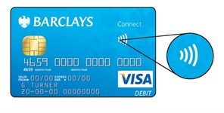
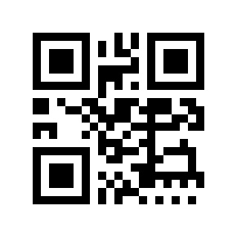
The Internet of Things
Many devices connected to the internet
Current consumer use: Hive and Nest
Medical monitoring (for example FitBit fitness tracker)
Dynamic interaction between components of a transport system
Most devices will connect ‘wirelessly’
Contactless cards
QR and other optical readers
Bluetooth
Wi-Fi
Wireless technologies have to be secure!

Slide 11
Internet addressing
IP version 4
IP version 6
372.78.134.82
4,294,967,296 possible unique addresses
Some reserved for ‘special purposes’
Rapidly running out
So slow transition to IP v6
Hexadecimal format
2002:4559:1FE2:0:0:0:4559:1FE2
340,282,366,920,938,463,463,374,607,431,768,211,456
Will be needed for the Internet of Things

Slide 12
Your life in their hands?
Governments
Corporations
Organisations
Who can you trust?

